Slide 1
WindAll – Optimised Filament Winding
International Conference on Manufacturing of Advanced Composites 2025
Dr. Tim Swait
^{Technical Fellow}

Slide 2
Contents
Filament winding process
Generation of paths
Analysis of performance
Optimisation
Post-processing
Manufacturing

Slide 3
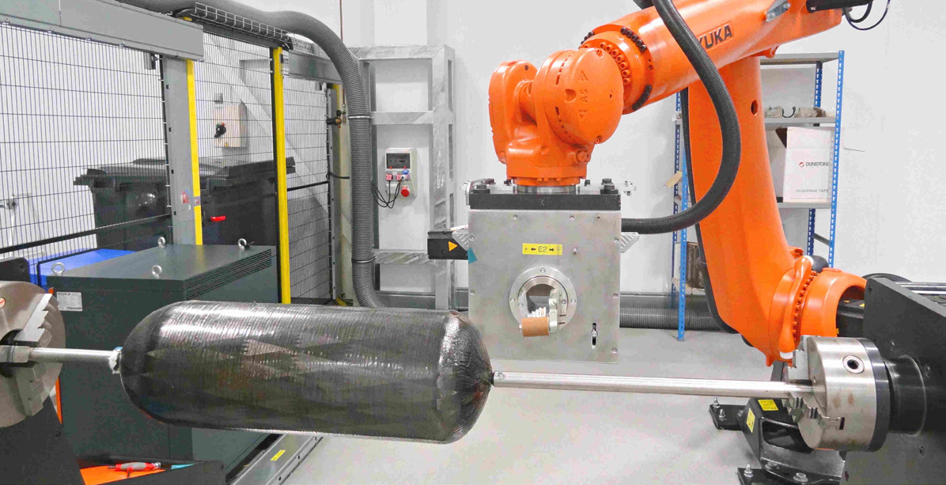
Filament Winding
Inherently a low cost process; low wastage and input materials are in a unprocessed form
Automated, repeatable and accurate process
Robotic systems are capable of many, complex motions
However is commonly only used for simple, mostly axisymmetric, shapes.
Programming a limiting factor.
Most commercially available software only able to handle axisymmetric shapes or individual special cases (like certain angles of elbow)

Slide 4
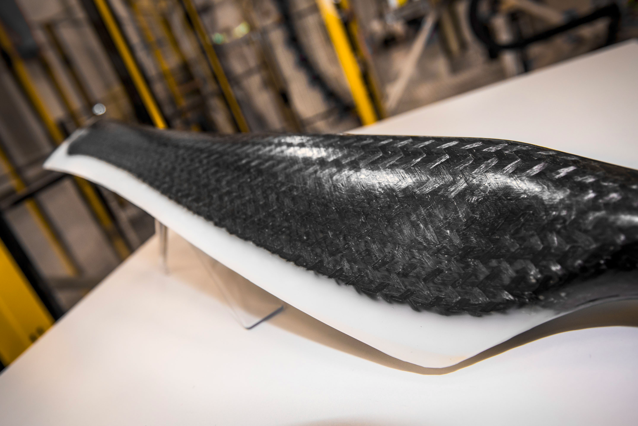
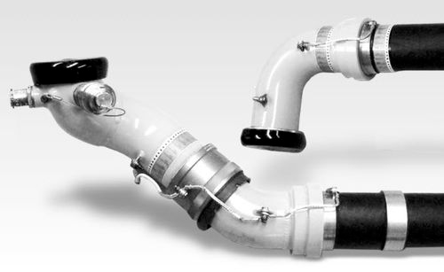
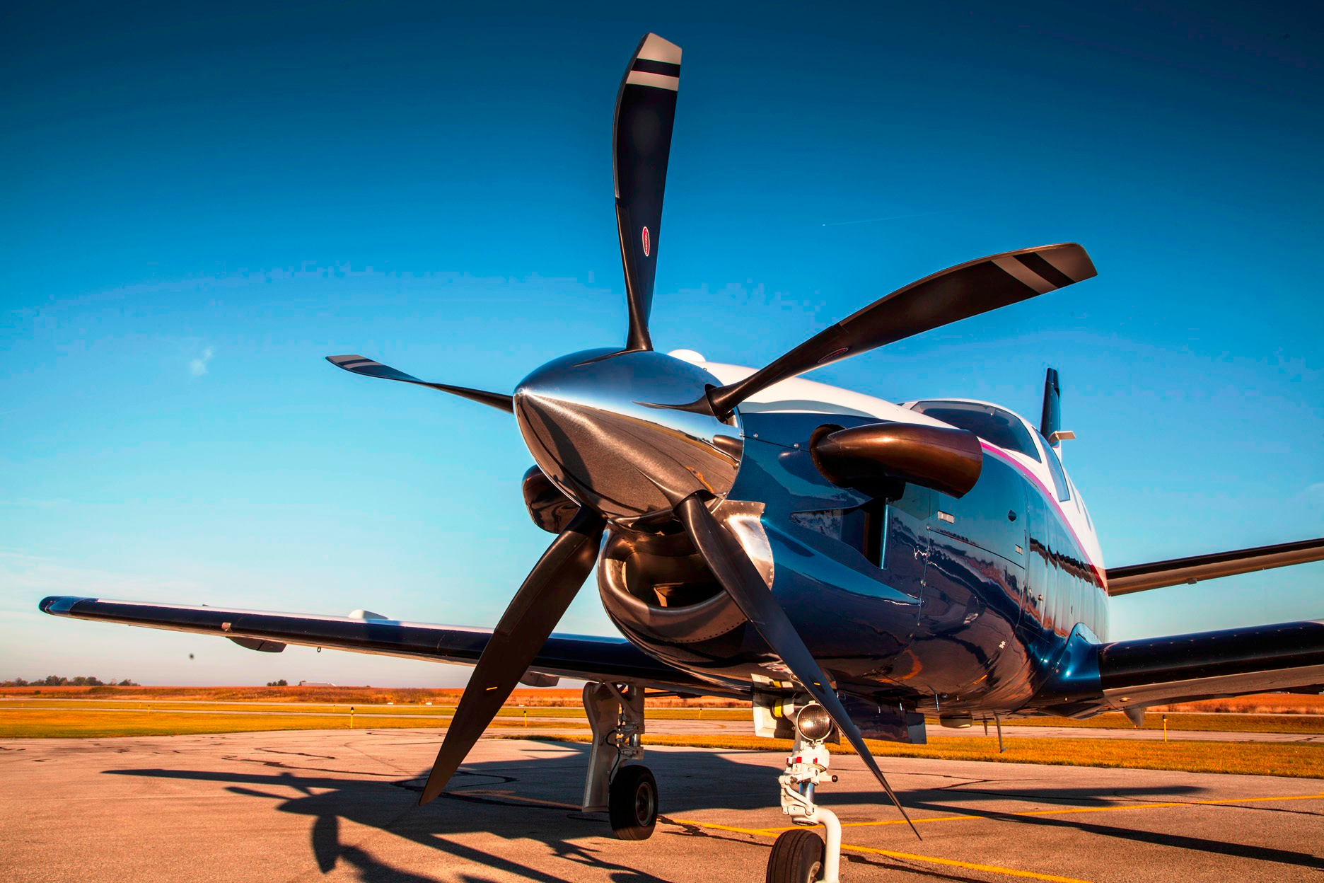
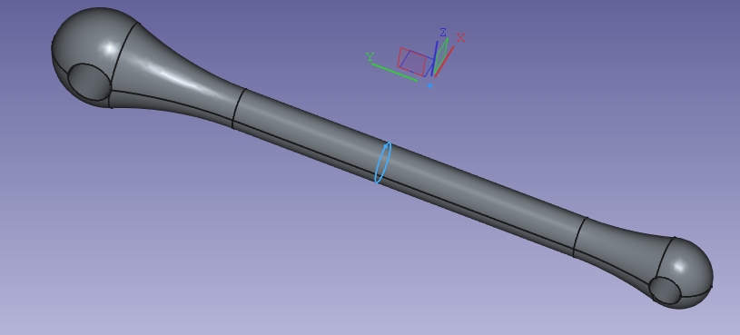
Filament Winding
However, there are many complex, non-axisymmetric shapes that we might wish to wind, such as:
Propeller or fan blades
Complex ducting (curving and/or non-circular cross section)
Link parts such as control arms, tie rods or levers

Slide 5
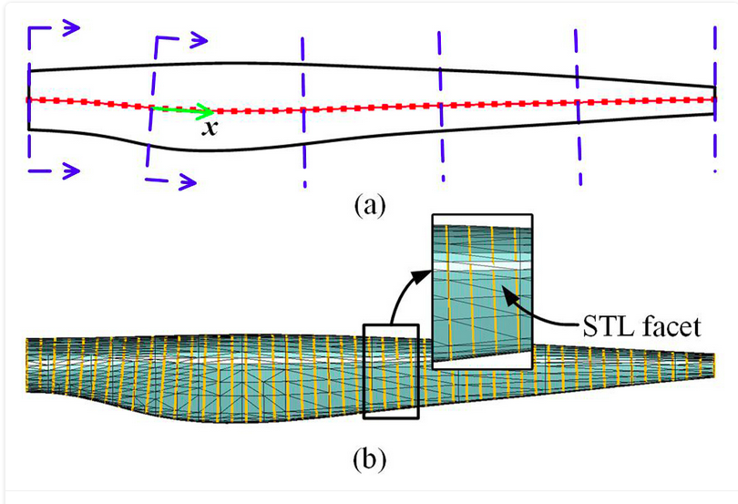
Filament Winding
Non-axisymmetric shapes.
Some academic literature on winding non-axisymmetric shapes
A lot of this concentrates on the problem of generating regular, repeating patterns.
In principle, why is that necessary though?
Surely, if a wind meets a performance requirement, then does it matter if it’s irregular and doesn’t repeat?
R Man, Z Ma, Z Yin, L Ye, and W Ma, "Filament winding pattern generation for non-axisymmetric mandrels based on path adaptive adjustment", Journal of Composite Materials, 2024.

Slide 6





Software stack
Open Source
FreeCAD used for parametric geometry creation, since this is fully scriptable with Python, the geometry can also be included in the optimisation
Meshing done within FreeCAD by Gmsh
Code Aster (version packaged by Nix) used for Finite Element Analysis
Path creation, FEA pre and postprocessing and writing of robot control files all written in Python to run within a modified branch of FreeCAD
WindAll code available Open Source here:
https://github.com/AMRC-Composites

Slide 7
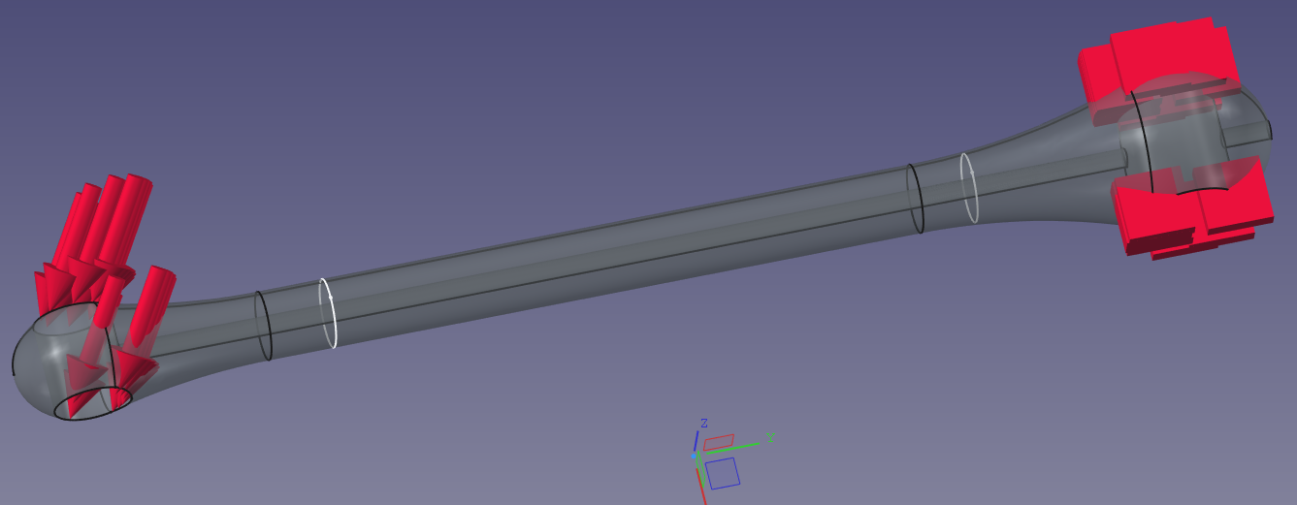
Tie rod
Choice of part
We needed a complex part to test the approach on.
A tie rod was chosen as it is non-axisymmetric (elliptical cross section), tapering, has interesting ends to wrap over and also has the pair of bores to avoid (which also break the axisymmetry)
A load case was chosen, fixing one end and applying an angled force to the other to impose mixed tension, bending and torsion
A maximum deflection limit was set.

Slide 8
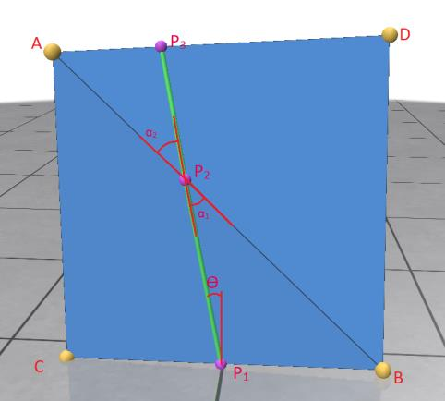
Path generation
Geodesics
Filament winding is a process which requires the fibre paths to be close to geodesic (some steering is possible, especially on more convex surfaces)
A geodesic on a flat surface is a straight line
The process for generating geodesic lines across a mesh is therefore very simple in principle
A straight line is projected across each face of the mesh.
On reaching an edge it is projected onto the next face such that α1 = α2

Slide 9
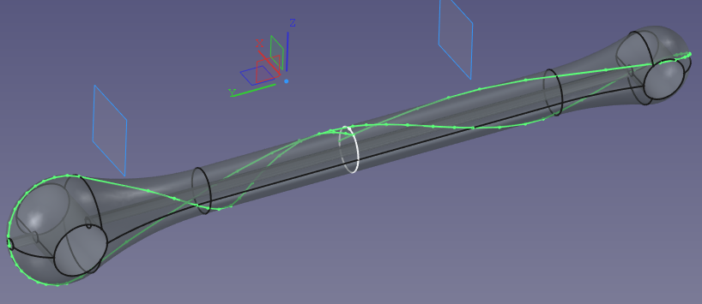
Path generation
Where to start?
So now we can start a geodesic path from anywhere on the surface at any angle, but where and what angle?
This wire can run on indefinitely in principle
Although for a complex case such as this, it might hit an unwindable section, either lifting from the surface (over a concavity) or falling off an edge.
So really we need to answer 3 questions:
  Where to start?
  Where to miss?
  When to stop?
The problem is to parameterise those questions.

Slide 10
Path generation
Drivecurves
We’ve tackled the “Where to start?” question with a ‘Drivecurve’
This is a closed sketch on some cross section of the mandrel
You can then parameterise according to the distance around the curve and the starting angle relative to the curve
This can also be used to control throughout the winding as the angle and position can be nudged each time the path crosses the drivecurve

Slide 11
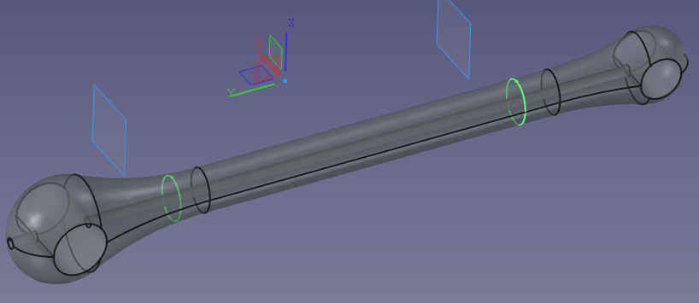
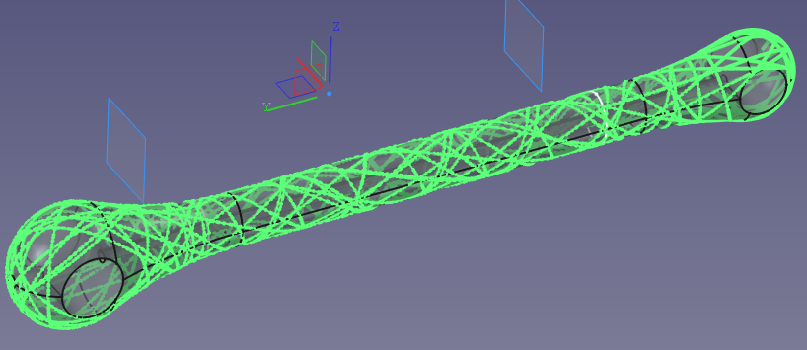
Path generation
Two drivecurves are better than one.
In practice for this part, we used two drivecurves, one near to each end
The angle could therefore be nudged separately across 3 sections; the section between the drivecurves and each end sections
This enabled us to make a continuous path, missing the holes and with a parameterised angle (which could be varied throughout the layup if desired)

Slide 12
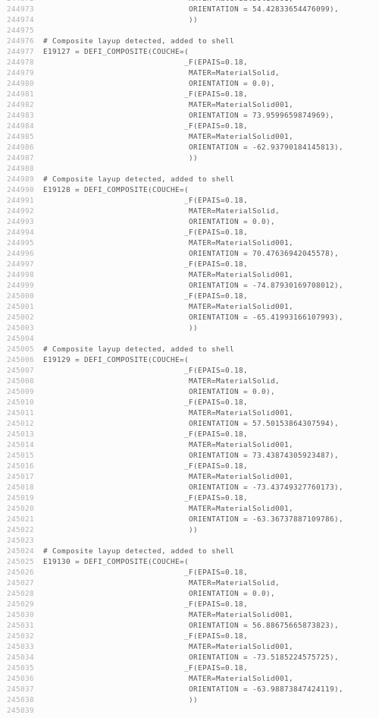
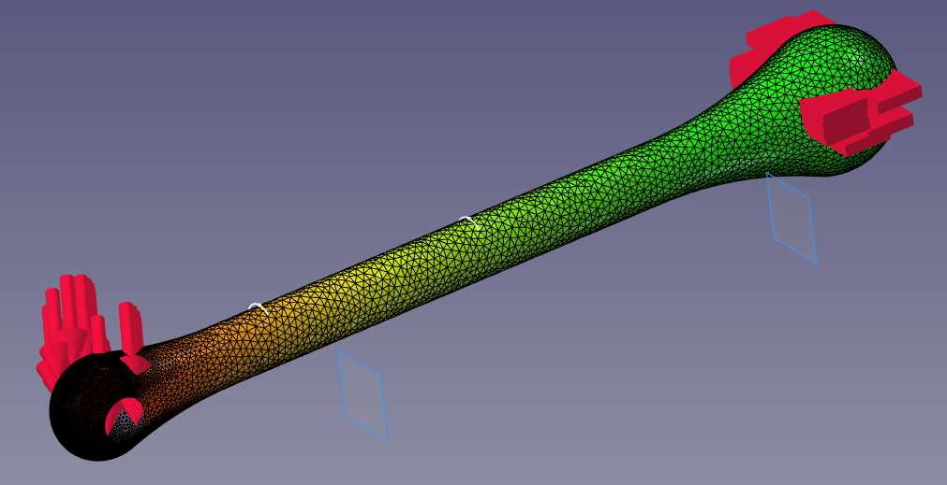
Analysis
Laminate definition
Every element has to have a unique lay-up!
For every element, each path which passes within ½ tow width of the centroid of the triangle increments that element in thickness by the tow thickness and also record the angle.
This is written into a Code Aster input file
The solver is run and the results read back in

Slide 13
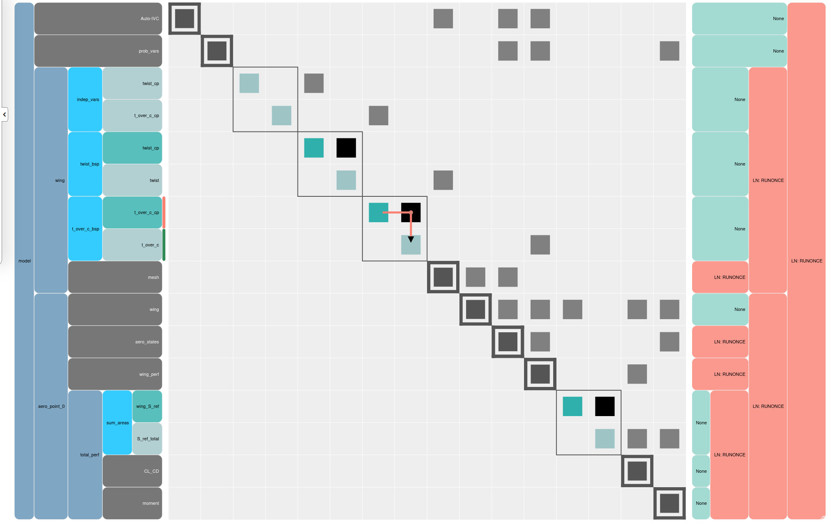
Optimisation
Partial optimisation
More work is needed on the optimisation loop
However in principle we now have a list of parameters and a process to follow which results in an output
These parameters and process can be fed into a general purpose optimiser to minimise a given performance function (such as the the minimum amount of material needed to meet the deflection criterion)
Shortcuts in this process can be identified
Potentially a complex optimisation frame work such as OpenMDAO may be required
Potentially stress and/or strain could be used to guide the path generation process

Slide 14
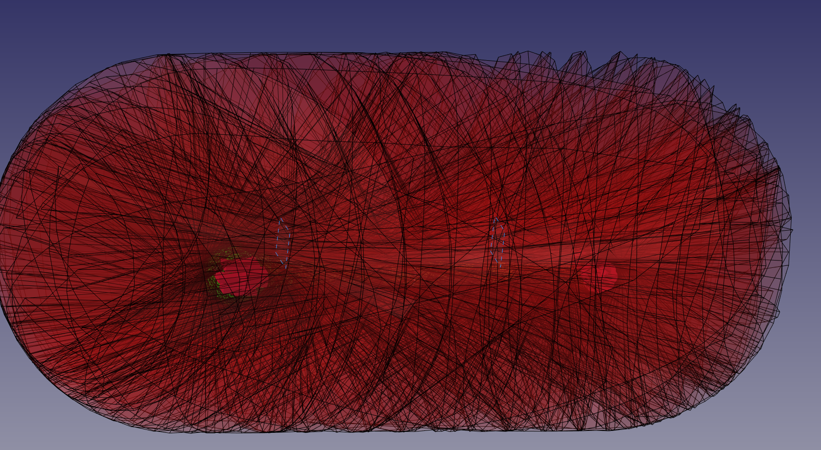
Post-processing
Even more ideally, the extra degrees of freedom could be used to allow smoother and faster robot motions and for example to minimise the amount of re-winding required
Robot programming
In principle, at each point the path is projected out into space and the mandrel is rotated and the robot head moved so as to place the payout eye at that point
In practice, the robot has many more degrees of freedom than is strictly required for this
We therefore decided to fix z and have x as a constant value in the centre with an arc at each end
Ideally, this shape should be set by another sketch

Slide 15
Part manufacture
Yes, we got one made!

Slide 16
t.swait@sheffield.ac.uk

Slide 17
Colour palette
Primary and Secondary colours
For consistency, wherever possible please use these colours.
The below colours are already created as 'Theme Colours’ for ease of use.
Primary
The main colour palette.
Secondary
A supporting colour palette.
Slide titles
and body text
Subheadings

